Slide 1

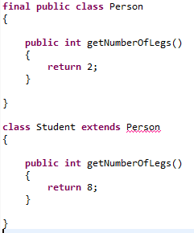
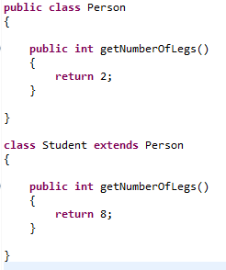


Final Class
We can also declare an entire class final. A class that is declared final cannot be subclassed. This is particularly useful, for example, when creating an immutable class like the String class.

